Slide 1

Education VCE Passing Score- ATAR (or equivalent) of success
GROUP 6
Josh Martin
Peregrin Ryan
Udeshi Pereira

Slide 2

Introduction
WHAT IS AN ATAR SCORE AND HOW IS IT CALCULATED ACCORDING TO VCE SCALING?
The ATAR is a ranking of Year 12 results that measures your overall academic achievement compared with all other final year students in Australia. The ATAR is not a score out of 100 – it is a rank. The ATAR allows tertiary institutions to compare the overall achievements of all students who have completed Year 12.

Slide 3

Project Overview
Features
Analysis of School Data Victoria
Geolocation wise performance
School wise Geolocation analysis
Geolocation wise analysis (Median ATAR, ATAR over 40% )
Analysis of source of Study
Which school sector has best chance of success
Geolocation Gov vs Non-Gov (Median ATAR, ATAR over 40%)
Find optimal Geolocation and Gov vs Non-Gov

Slide 4

Results from data cleaned up process Research page: https://asl.acara.edu.au/about-asl https://bettereducation.com.au/results/VCE_ATAR.aspx
Josh Martin

Slide 5
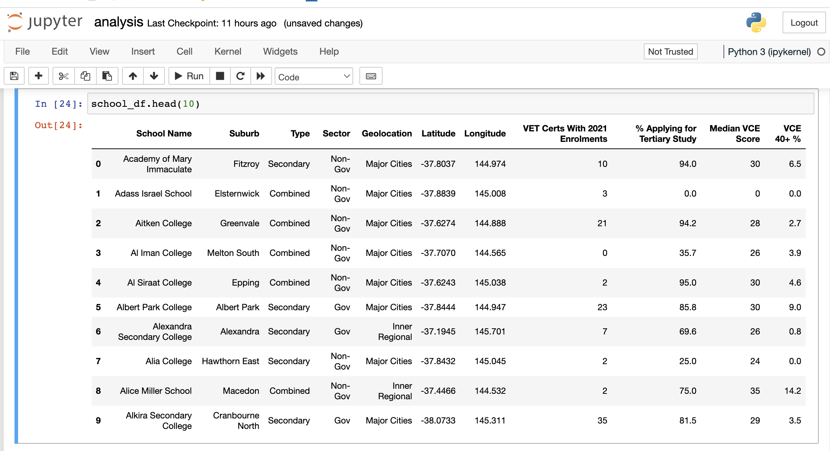
Cleaned up data set

Slide 6
Which students get more benefits according to the Geolocation? Inner Regional School sector distribution Gov 84.6% Non-Gov 15.4% Major Cities School sector distribution Gov 51.2% Non-Gov 48.8% Outer Regional School sector distribution Gov 84.6% Non-Gov 15.4%
Josh Martin

Slide 7
This study’s objective is to further analyse population density changes in Victoria in the year 2021 The first hypothesis of this study is that cities population density is increasing compared to population density in towns and town-cities in year 2021. The second hypothesis of this study is that population density in main cities is increasing compared to population density in their neighbour towns and town-cities in year 2021
Hypothesis

Slide 8
Defining rural and regional
In this study, ‘rural’ and ‘regional’ refer to locations outside City centres that have populations of 100 000 or more, which for Victoria means locations outside Melbourne and Geelong. Combining measures of population sparsity (persons per square kilometre) with scores from the Accessibility/Remoteness Index of Australia (ARIA) provided a means for ranking schools and populations and dividing them into seven categories:
Major city (Melbourne and Geelong)
Provincial city (e.g., Ballarat and Bendigo)
Provincial centre (e.g., Mildura, Swan Hill)
Large town (e.g., Leongatha, Lorne)
Small town (e.g., Terang, Skipton)
Rural (e.g., Bright, Donald)
Remote (e.g., Orbost).

Slide 9
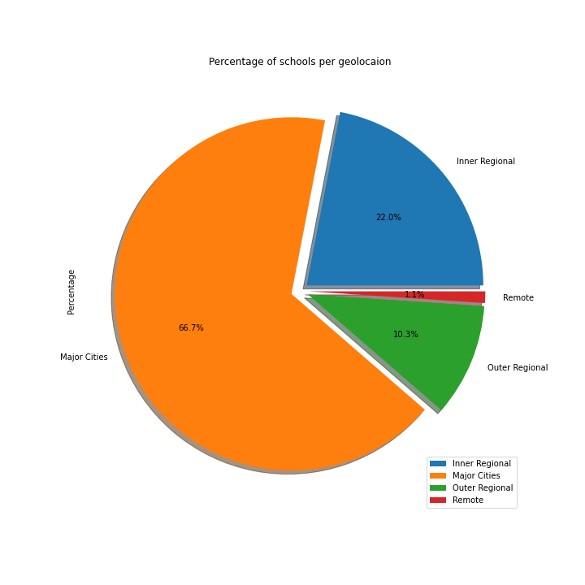
Percentage of schools per Geolocation

Slide 10
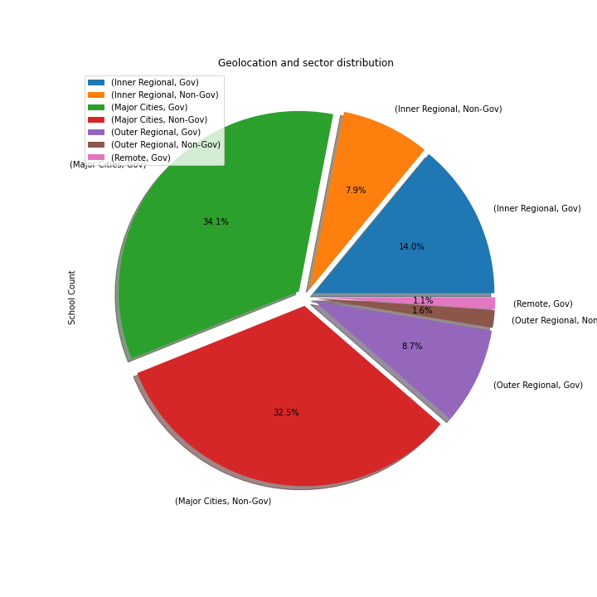
Geolocation and sector distribution

Slide 11
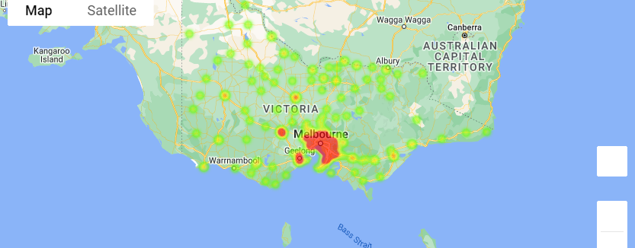
School Geolocation heatmap

Slide 12
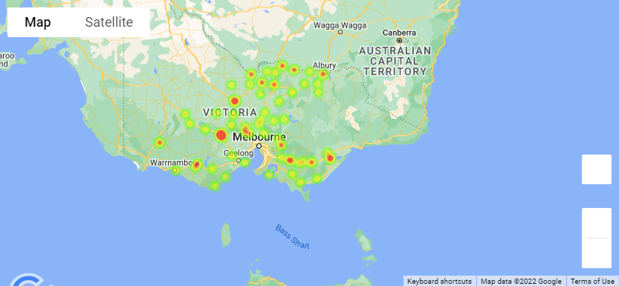
School Geolocation heatmap Inner Regional

Slide 13
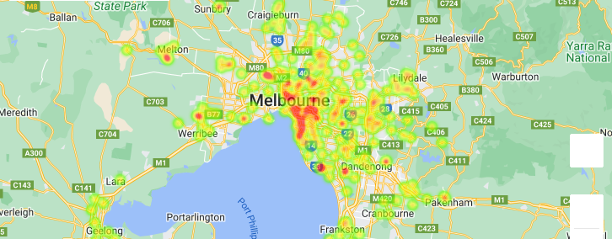
School Geolocation heatmap Major Cities

Slide 14
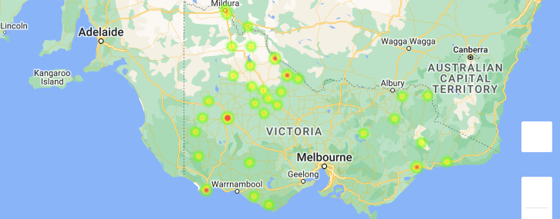
School Geolocation heatmap Outer Regional

Slide 15
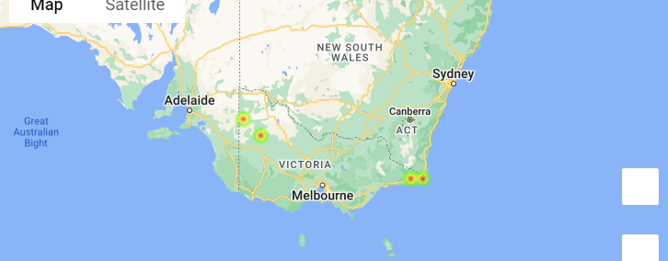
School Geolocation heatmap Remote

Slide 16
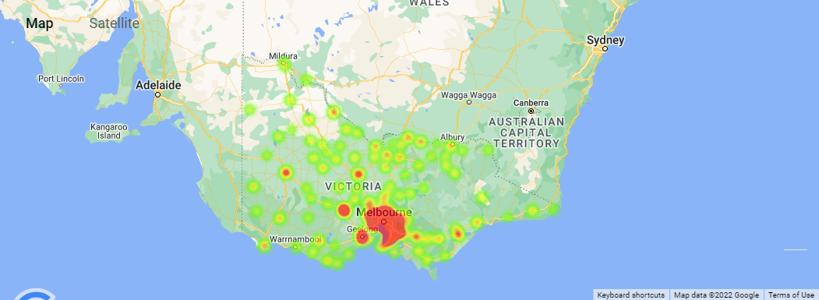
Territory heatmap

Slide 17
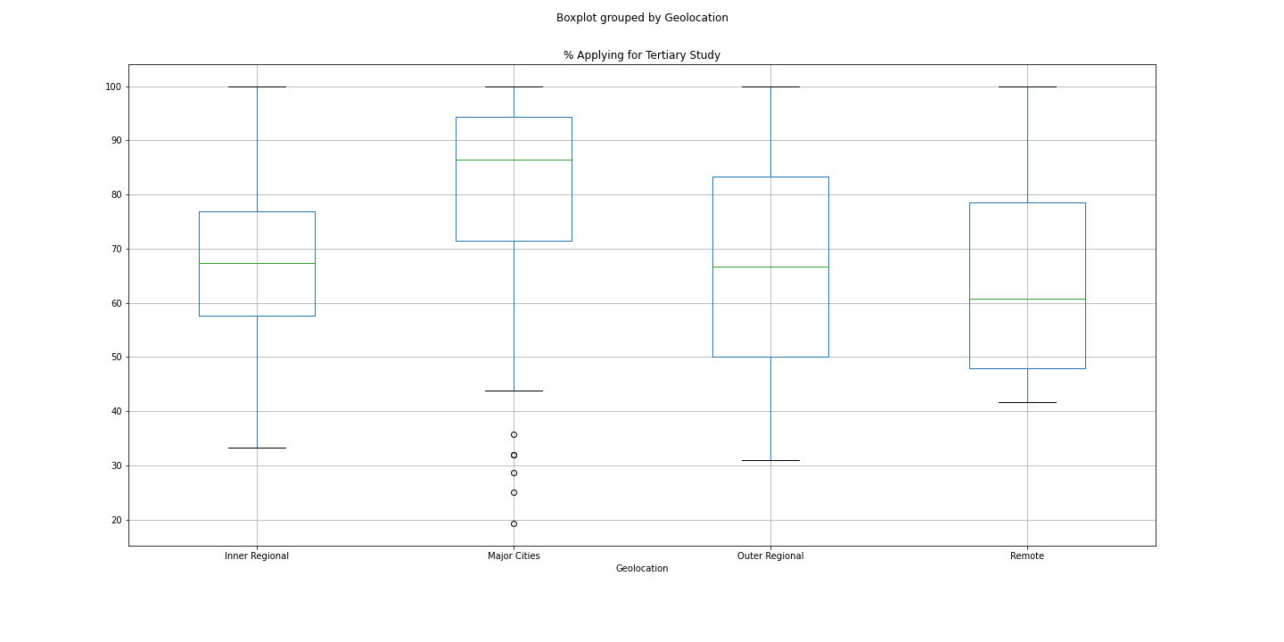
Boxplot grouped by Geolocation

Slide 18
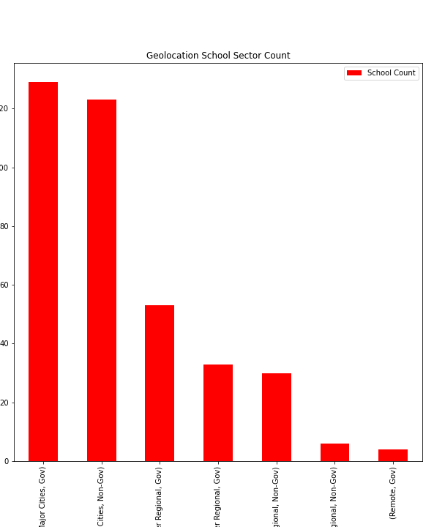
Geolocation School sector count
Geolocation School sector count

Slide 19
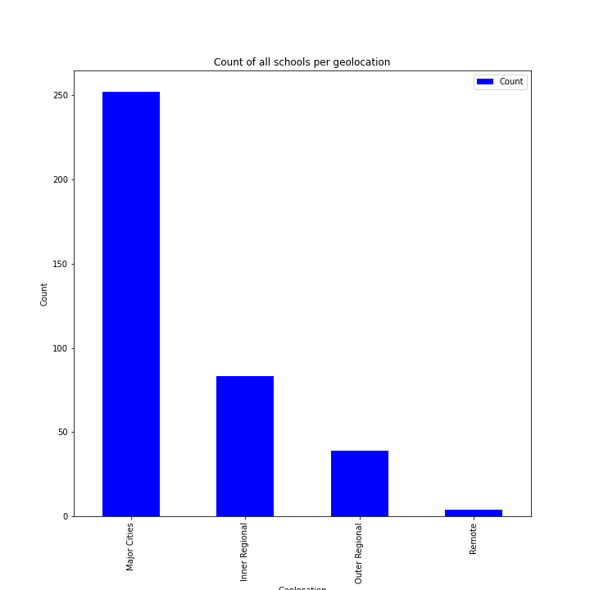
Count of all schools per Geolocation
Which students has more choices of schools between gov or non gov?
Number of school
Number of Gov and Non-gov

Slide 20
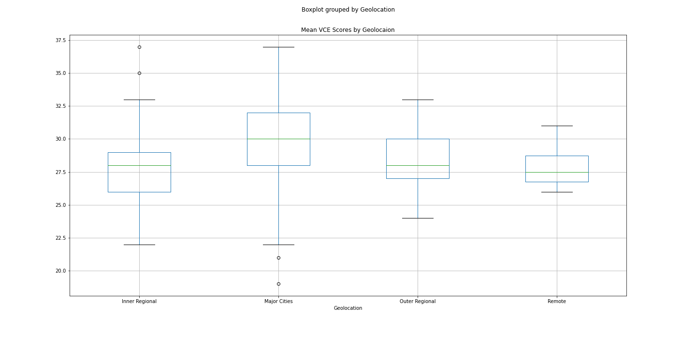
Mean VCE Box Plotting

Slide 21
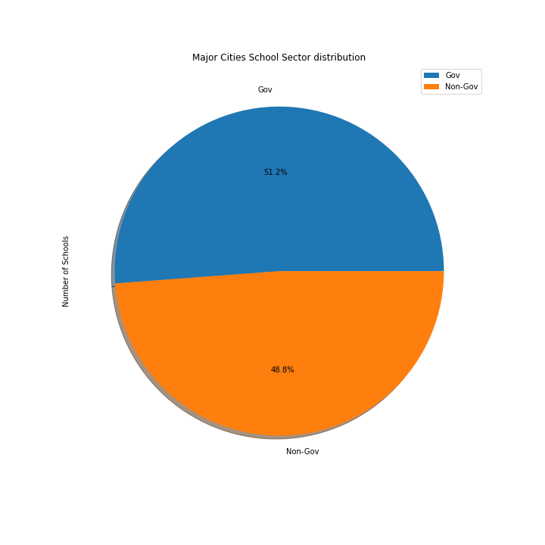
Major Cities school sector distribution

Slide 22
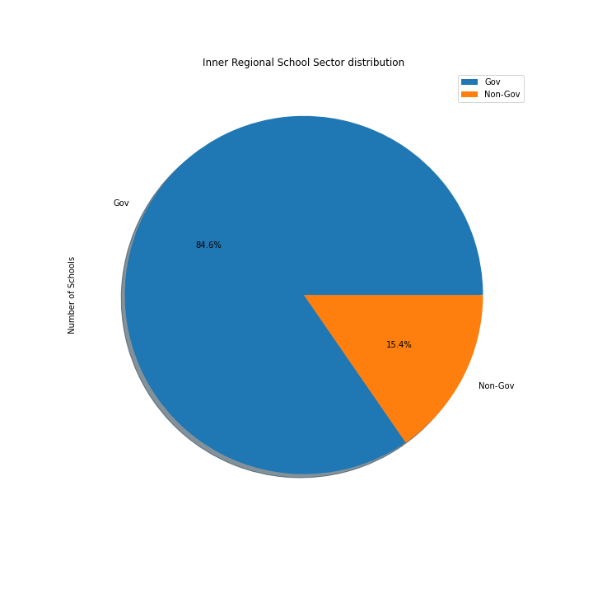
Inner Regional Sector distribution

Slide 23

Outer Regional Sector distribution

Slide 24
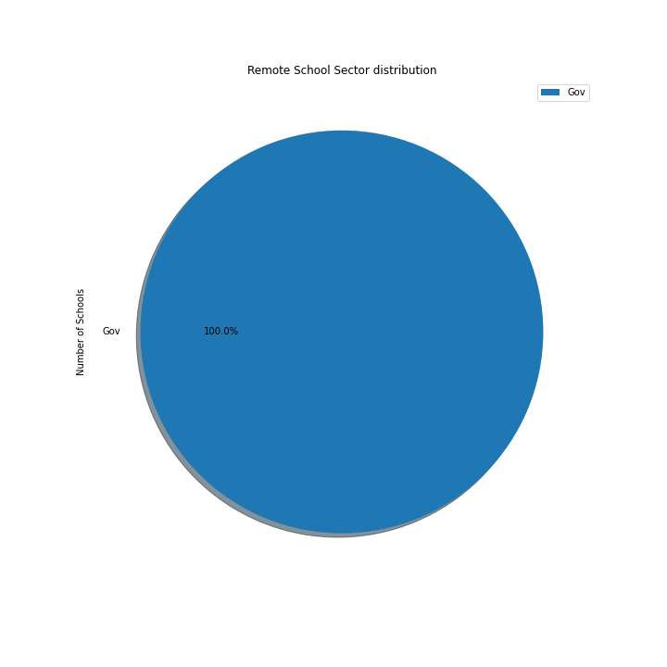
Remote School Sector distribution

Slide 25

The implications of your findings; What do your findings mean?

Slide 26
Which have the best chance of success
01
02
03
Geolocation
(Median ATAR, ATAR over 40% )
Find optimal Geolocation and Gov vs Non-Gov
.
Gov vs Non-Gov
(Median ATAR, ATAR over 40%)

Slide 27


Slide 28
Summary

Slide 29

Conclusion
Rural and Regional schools tend to be smaller than Major Cities schools.
This can have a number of disadvantages as well as benefits for rural and regional students.
On the one hand, class sizes tend to be smaller, students enjoy more individual attention from their teachers, and teachers often know most, if not all, the students.
On the other hand, smaller schools tend to have fewer resources, are often less able to employ specialist staff or offer specialist subjects or programs, have to use composite multigrade classes,
provide fewer opportunities for professional development, have more difficulty recruiting and retaining teachers, provide less support for special needs students and offer fewer options for courses.

Slide 30
Group 6
Peregrin Ryan
Josh Martin
Udeshi Pereira

Slide 31
Goals for Q2
Business opportunities
Added priorities
Employee priorities
Increase customer satisfaction by 2%
Maintain growth
Decrease the number of rotations by at least 2
Ensure the cost of development stays below budget
Interns begin
Indoor rec leagues
Chess tournaments
Big Game watching party

